Slide 1
CS 518-Web Programming Group 3.
MileStone-2 Midway Report

Slide 2

CryptoTalk!
By:-
Aniket Chandak
Aniket Nawade
Akshay Dabade

Slide 3
Contents:
Milestone 1 Achievement
Milestone 2 Requirements
Message Reactions
Thread Management
User Profile
Screen Shots
Challenges

Slide 4
Requirements
Message Reactions
Thread Management
User profiles

Slide 5
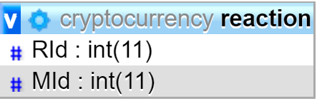
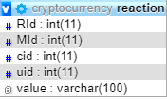
Message Reactions
Reactions. (+1 & -1)
No duplicate reactions.
Old Table
Updated Table

Slide 6
Thread Management
Creating a sub-thread.
Grouped messages.

Slide 7
Additional Features
User can delete his/her own profile.
User can leave the channel.
For account creation we can try integrating google/Facebook/twitter signup page.
Emoji’s button.

Slide 8
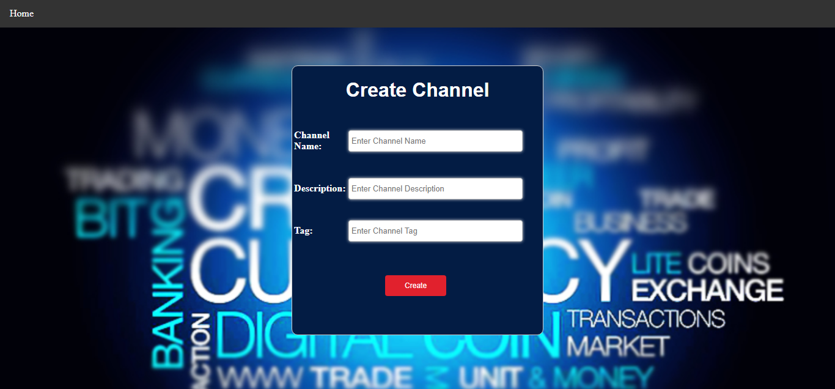
Screen Shots
Create Channel:-

Slide 9
Challenges
Maintain Unique reaction to each message by every user.
Thread management.

Slide 10
Thank You
Questions?

